Slide 1
COMPUTER FUNDAMENTALS
.
A 1.1 Computer Hardware and Operation

Slide 2
A 1.1.1 The CPU
Inquiry Statement : Describe the functions and interactions of the main CPU components.
Skills:
Students will be able to analyse the data flow and instructions within the CPU during the fetch-decode-execute cycle.
Students will be able to explain how buses facilitate communication between CPU components.
Students can evaluate the advantages and disadvantages of different processor types.
ATL Skills:
Communication: Students will effectively communicate their understanding of CPU architecture through discussions, presentations, and written explanations.
Collaboration: Students will work collaboratively in groups to analyse diagrams, solve problems, and complete activities.
Critical Thinking: Students will analyse the relationships between CPU components, evaluate different processor designs, and apply their knowledge to real-world scenarios.
Information Literacy: Students will effectively use online resources and research to deepen their understanding of CPU architecture.

Slide 3


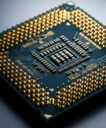

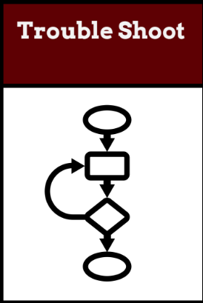
Do Now Activity (5 mins)
Identify the and explain the
Components of Computer
TOK
To what extent can data manipulation be considered an objective process when human judgment influences how databases are designed and interpreted?
Success Criteria:
I can identify and describe the main components of a CPU (ALU, CU, registers).
I can explain the functions of each CPU component and how they interact.
I can differentiate between single-core, multi-core, and co-processors.
Learning Intention:
Describe the functions and interactions of the main CPU components

Slide 4
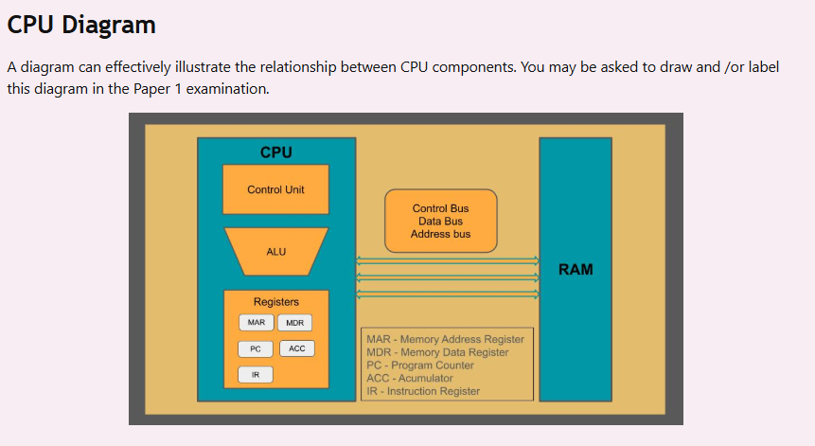

Slide 5
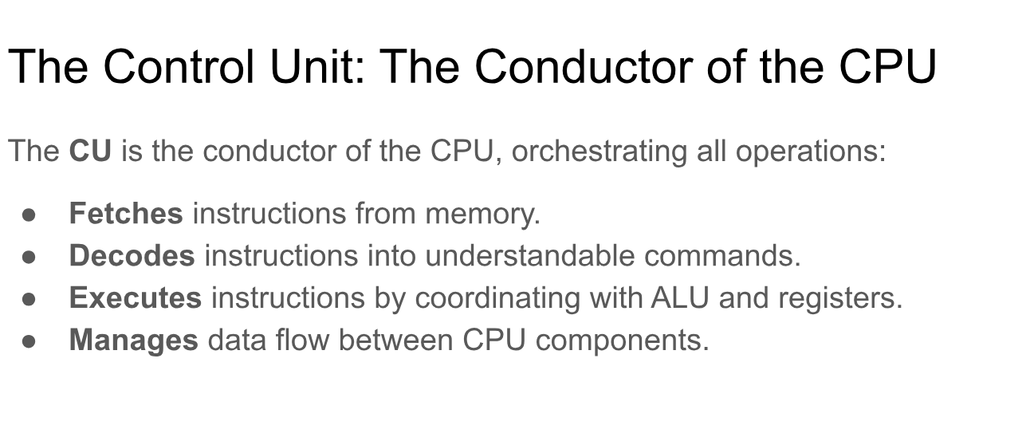

Slide 6
GROUP TASK
LEVEL 1 : Table 1
Create a PPT explaining the functions of each CPU component and how they interact .
LEVEL 2 : Table 2
Create a mindmap and differentiate between single-core, multi-core, and co-processors.
LEVEL 1 : Table 3/4
Create a PPT describing the main components of a CPU (ALU, CU, registers)

Slide 7
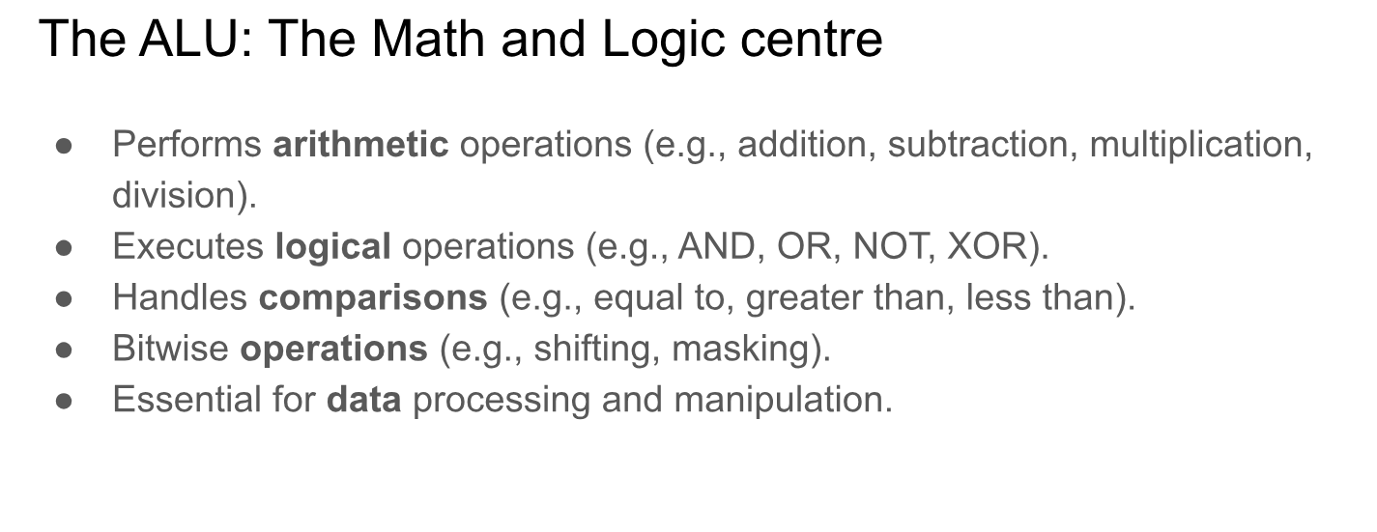

Slide 8
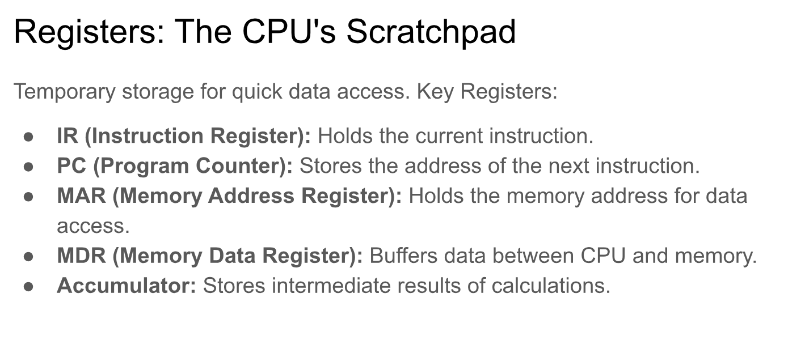

Slide 9
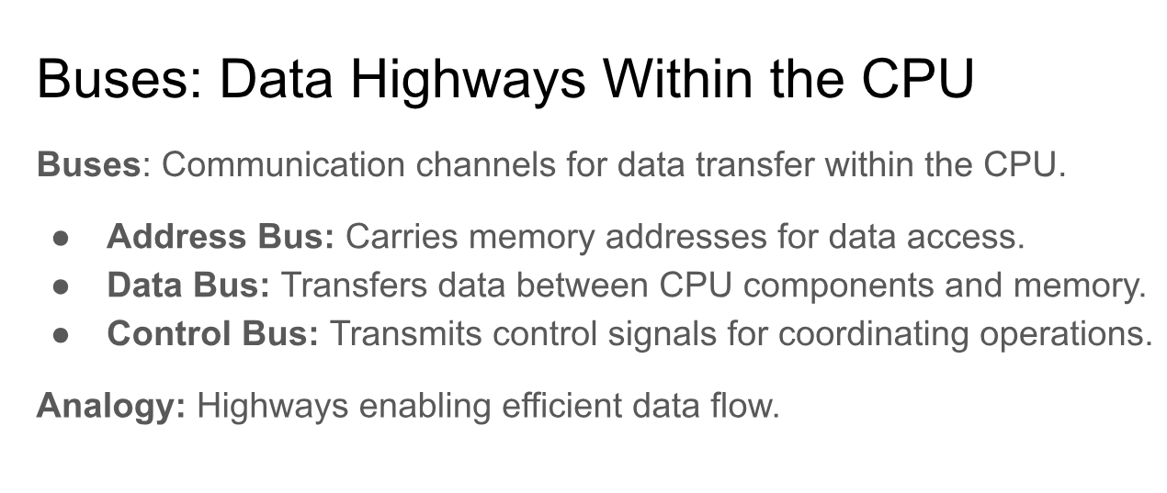

Slide 10
Evaluate (5 minutes)
students to answer individually as they leave the class:
"What are the two main units of the CPU, and what do they do?"
"Which register holds the address of the next instruction to be executed?"
"What is the purpose of the data bus?"

Slide 11
